Slide 1
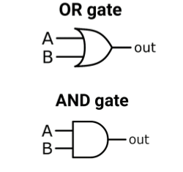

Logic Gates
Chapter 3
Week 1
Sumaiyah Zahid

Slide 2
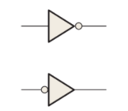
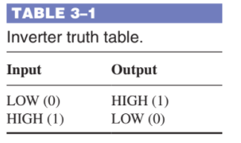
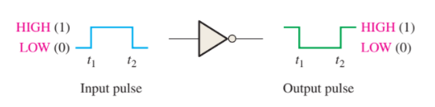
Inverter Or NOT Gate
Complementation

Slide 3
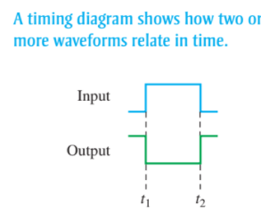
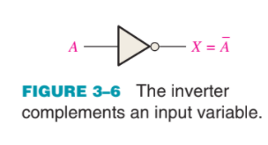
Inverter Timing Diagram

Slide 4
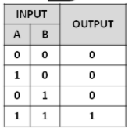
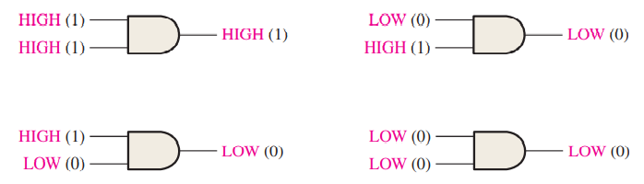
AND Gate
AND Gate = Boolean Multiplication

Slide 5
AND Gate
(a) Develop the truth table for a 3-input AND gate.
(b) Determine the total number of possible input combinations for a 4-input AND gate.

Slide 6
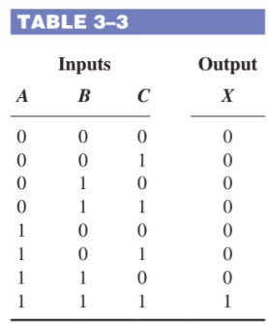
AND Gate
(a) Develop the truth table for a 3-input AND gate.
(b) Determine the total number of possible input combinations for a 4-input AND gate.

Slide 7
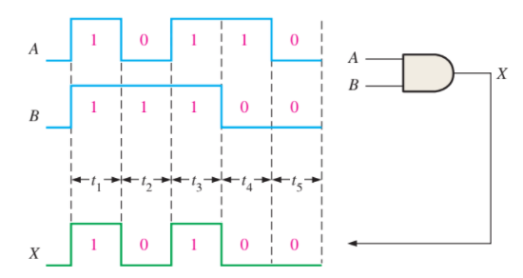
AND Gate Timing Diagram

Slide 8
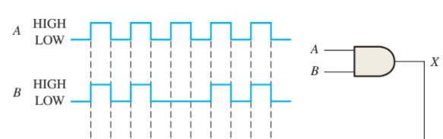
AND Gate Timing Diagram

Slide 9
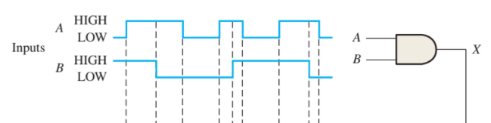
AND Gate Timing Diagram

Slide 10
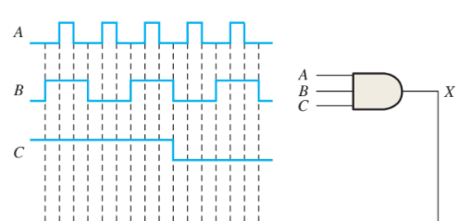
AND Gate Timing Diagram

Slide 11
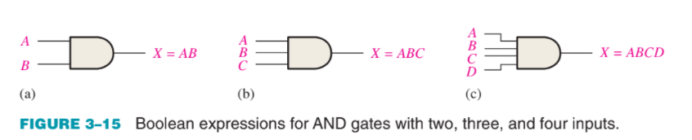
And Gate
Boolean multiplication is the same as the AND function.

Slide 12
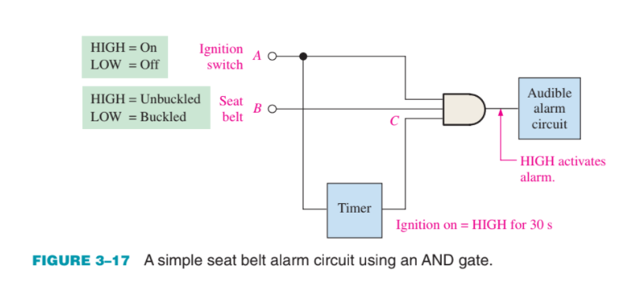
AND Gate Application

Slide 13
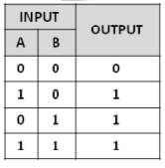
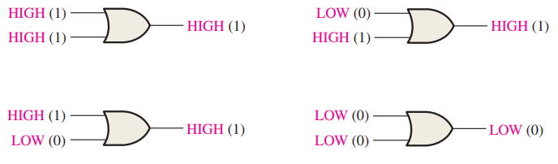
OR Gate
OR Gate = Boolean Addition

Slide 14
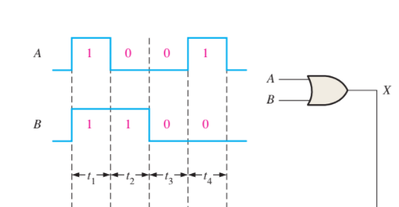
OR Gate Timing Diagram

Slide 15
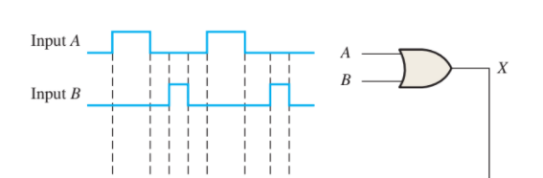
OR Gate Timing Diagram

Slide 16
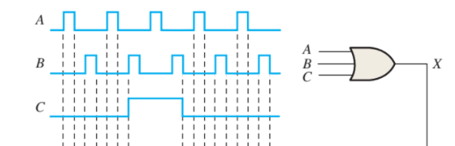
OR Gate Timing Diagram

Slide 17
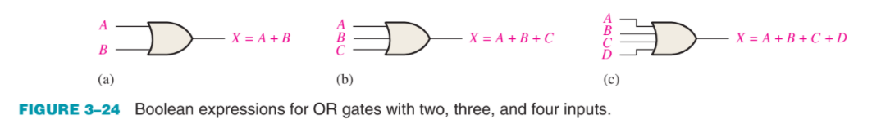
OR Gate
Boolean addition is the same as the OR function.

Slide 18
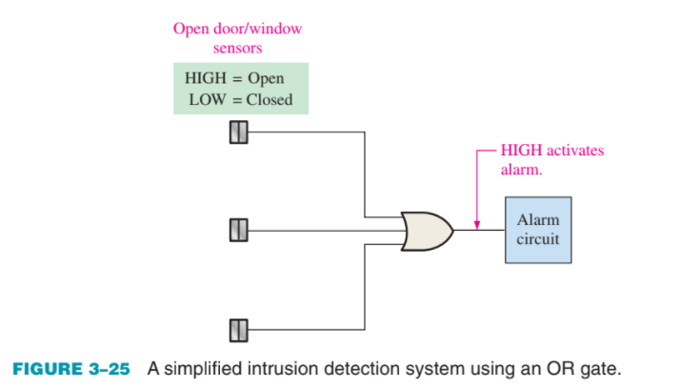
OR Gate Application

Slide 19
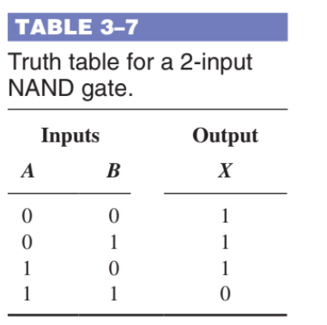
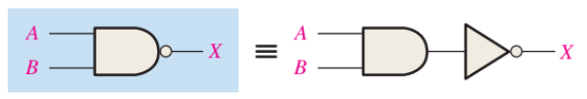
NAND Gate
NAND = Not AND
Also known as Universal Gate

Slide 20
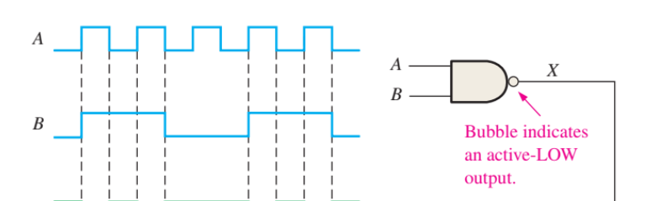
NAND Gate Timing Diagram

Slide 21
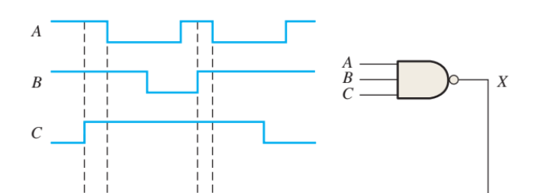
NAND Gate Timing Diagram

Slide 22
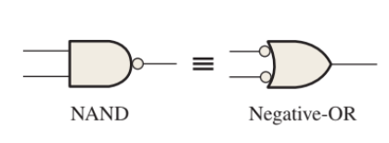
Nand Gate

Slide 23
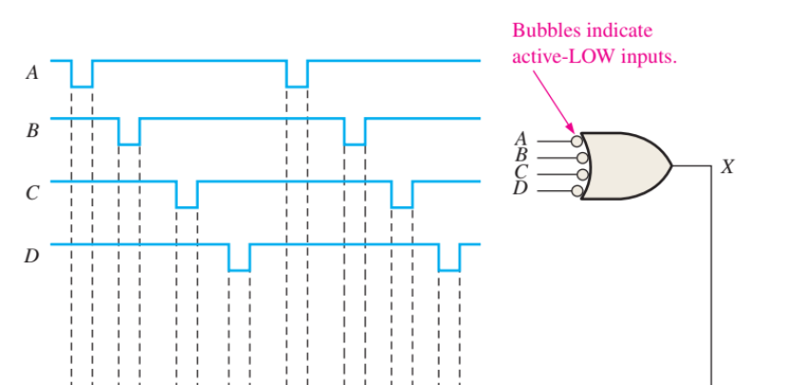
Nand Gate

Slide 24
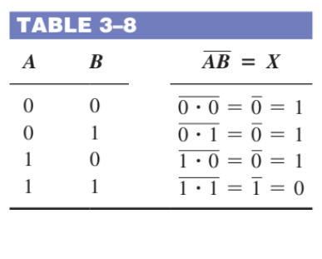

Nand Gate

Slide 25
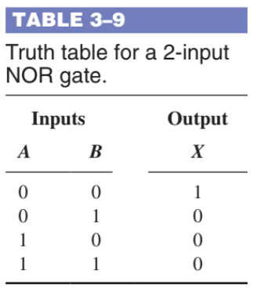
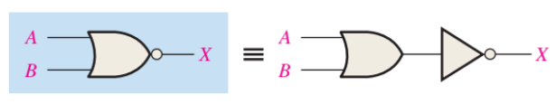
NOR Gate
NOR = Not OR

Slide 26
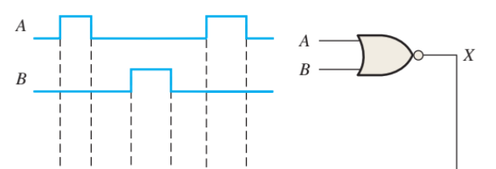
NOR Gate Timing Diagram

Slide 27
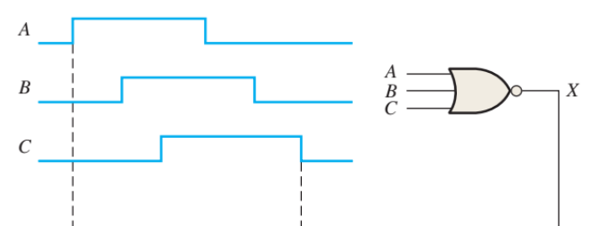
NOR Gate Timing Diagram

Slide 28
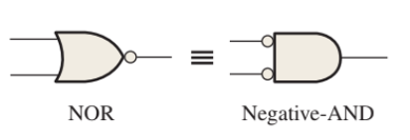
NOR Gate

Slide 29
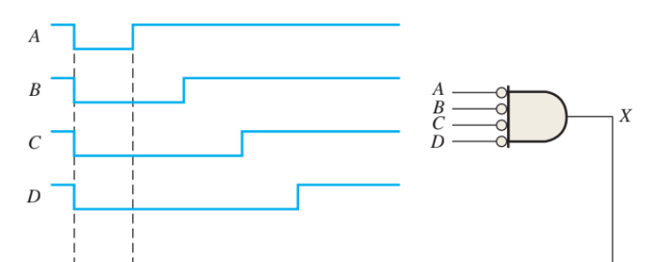
NOR Gate Timing Diagram

Slide 30
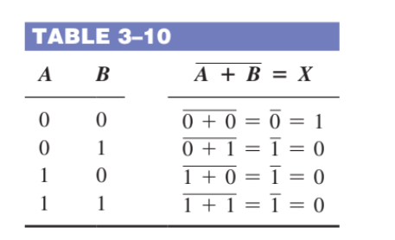

NOR Gate

Slide 31
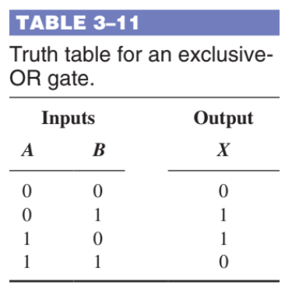
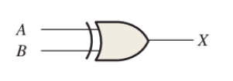
Exclusive OR Gate
Exclusive or XOR Gate
Performs modulo-2 addition

Slide 32
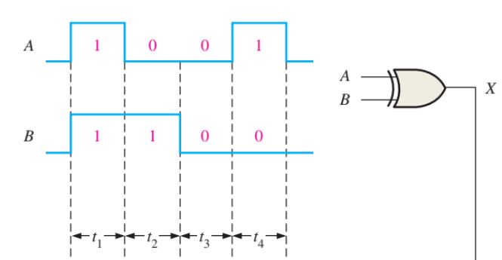
Exclusive OR Gate Timing Diagram

Slide 33
Exclusive OR Gate Timing Diagram

Slide 34
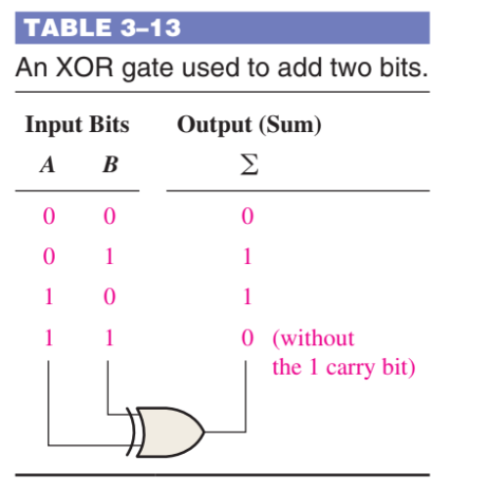
XOR Application

Slide 35
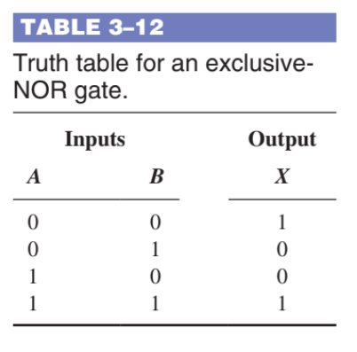

Exclusive NOR Gate
Exclusive NOT OR or XNOR Gate
Performs modulo-2 addition

Slide 36
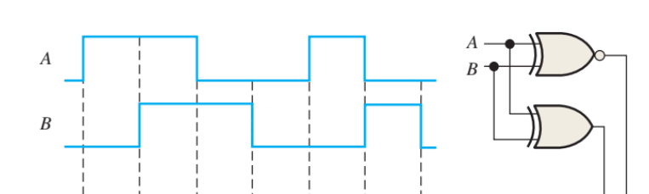
XNOR Gate Timing Diagram

Slide 37
